Slide 1
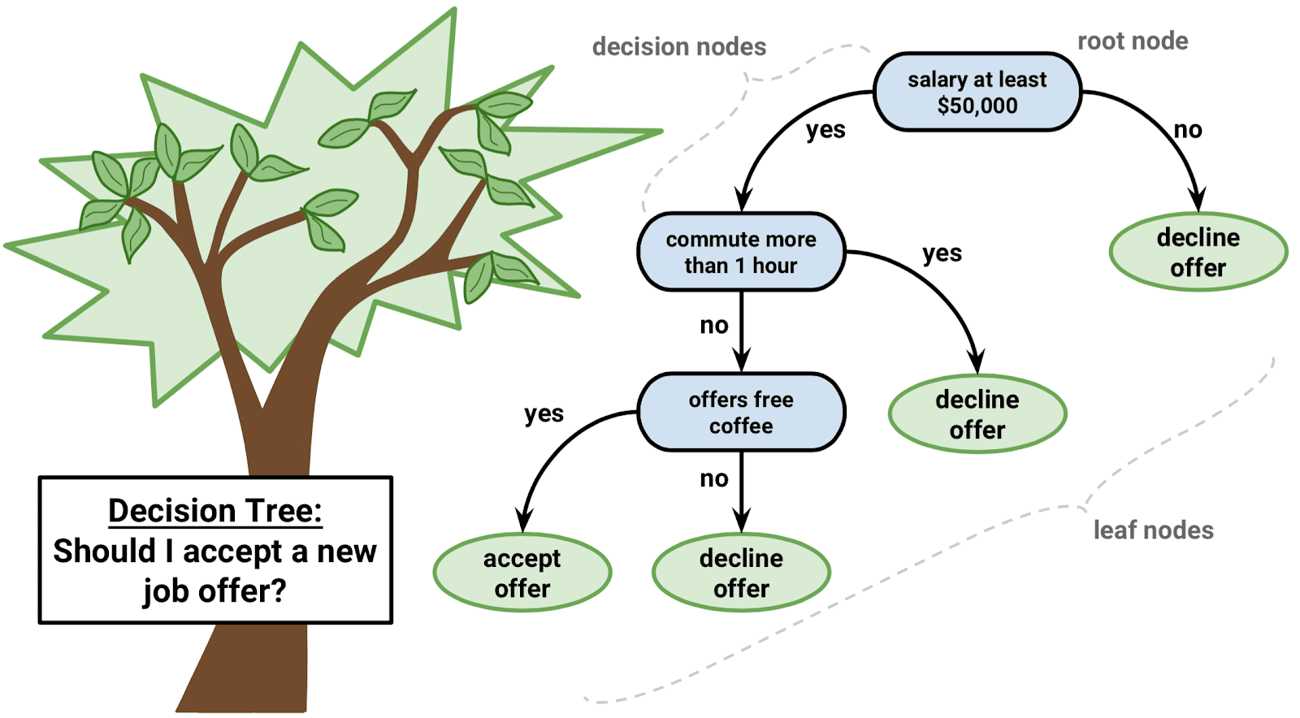
DECISION TREE

Slide 2
Introduction to Decision Trees
A decision tree is a popular supervised learning algorithm used in the field of artificial intelligence, particularly in data mining and machine learning. It is a flowchart-like tree structure where an internal node represents a feature, the branch represents a decision rule, and each leaf node represents an outcome.

Slide 3
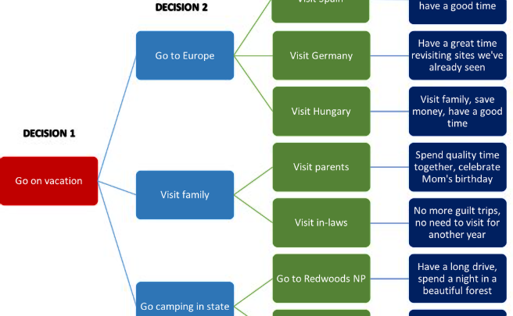

What is a Decision Tree?
Tree-like Structure
Top-Down Induction
A decision tree is a tree-like model that is built by recursively splitting the data into subsets based on the most significant attribute. This process continues until a stopping criterion is met, resulting in a tree structure resembling a flowchart.
It follows a top-down approach, where decisions for classification or regression are made at the top node, and the tree branches out to form the decision rules based on the values of the variables.

Slide 4
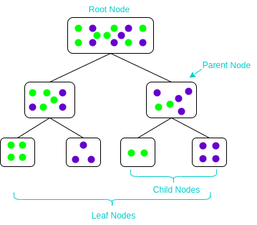
How do Decision Trees Work?
1
Attribute Selection
Decision trees select the best attribute to split the data at each node, aiming to maximize the information gain and minimize impurity.
2
Node Splitting
The dataset is recursively split into partitions based on the selected attributes, creating nodes that segment the data effectively.
3
Leaf Node Generation
Leaf nodes are generated based on specific criteria, resulting in the assignment of class labels or regression values.

Slide 5
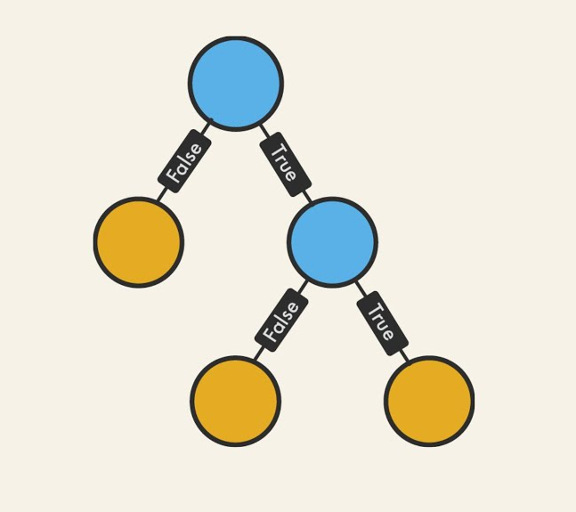
Advantages of Using Decision Trees in AI
Interpretability
Handling Missing Data
Decision trees provide clear and easy to understand decision rules, making them interpretable and suitable for knowledge representation.
They can handle missing values and are robust to outliers, reducing the need for extensive data preprocessing.
Applicability
They can be used for both classification and regression tasks, offering versatility and wide applicability in AI systems.

Slide 6
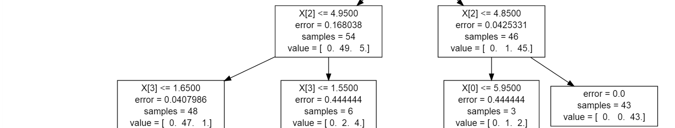
Limitations of Decision Trees
1
Overfitting
2
Instability
3
Difficulty with XOR Problems
Decision trees are prone to overfitting, especially in complex datasets, leading to generalization.
They are sensitive to small variations in the data, creating highly varied trees with minor data changes.
They struggle to solve the XOR problem, where no single decision boundary can separate the classes effectively.

Slide 7
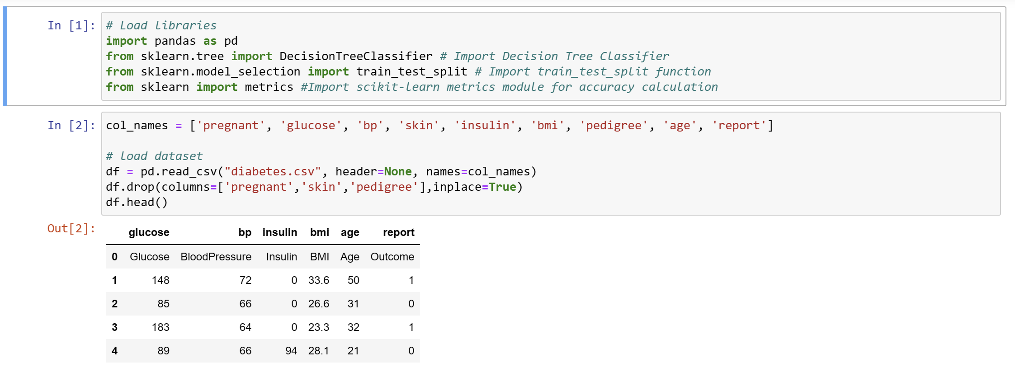
.

Slide 8
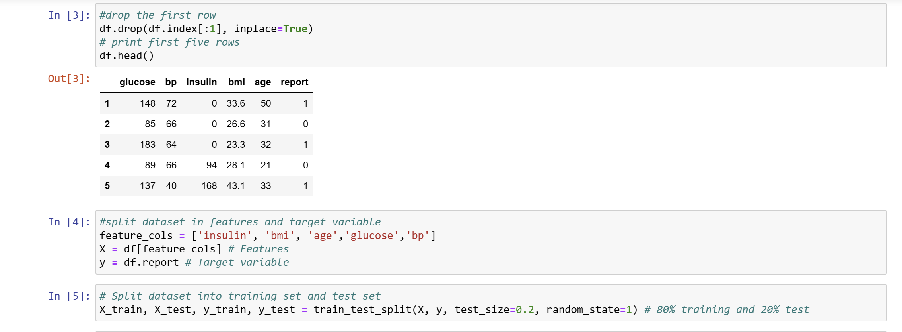
.

Slide 9
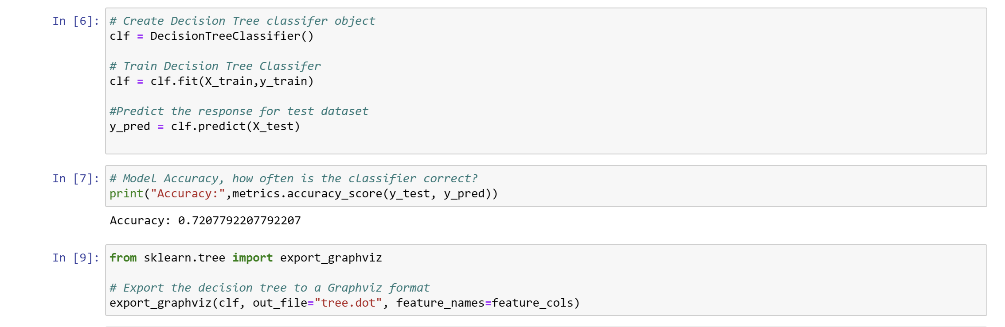

Slide 10
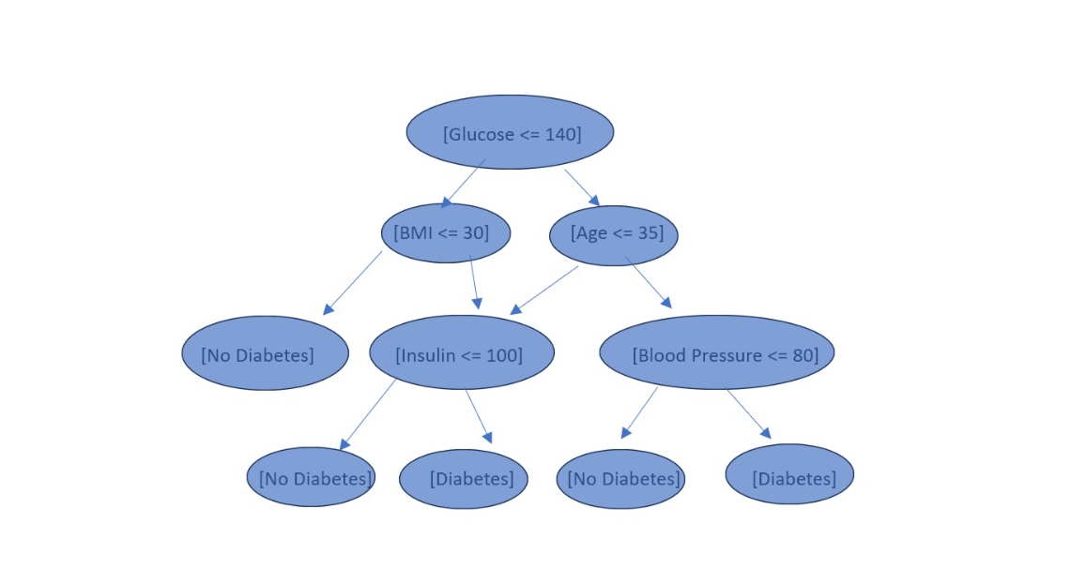

Slide 11
.

Slide 12




Practical Applications of Decision Trees in AI
Medical Diagnoses
They are employed in healthcare for diagnosing diseases and predicting patient outcomes based on medical test results and patient characteristics.
Financial Risk Assessment
Used in banking and financial sectors to assess credit risks, identify potential loan defaults, and determine creditworthiness.
Customer Relationship Management
Companies utilize decision trees to segment customers, predict buying behaviors, and personalize marketing strategies based on customer attributes.

Slide 13
Conclusion and Key Takeaways
Powerful and Transparent
Decision trees are powerful and transparent, allowing for the interpretation of complex relationships in data.
Prone to Overfitting
It's important to apply pruning techniques and ensemble methods to mitigate the risk of overfitting.
Valuable Tool in AI
Despite their limitations, decision trees remain a valuable tool in AI, especially in domains where interpretability is crucial.

